Slide 1

ELL Leadership Academy
Karina E. Chapa, M.Ed.
Language Proficiency, Biliteracy
and Cultural Diversity Director
kchapa@esc1.net

Slide 2
Professional Learning Essential Agreements
Be respectful of others
Be an active participant
Take care of your needs
Use electronic devices as learning tools

Slide 3

Edmodo Code: w9cqfd
Post a comment on one idea that called your attention from Chapter 3.
Respond to least one person’s comment.
www.edmodo.com

Slide 4
AGENDA
The Power of Acceleration
ELL Subpopulations: Special Ed GT
HEAT Framework Evaluation

Slide 5
HEAT Framework
HEAT + LOTI

Slide 7

Turning Up the HEAT!
Secondary: The Math Trail
Notes:
Click on the link to watch Ms. Toliver’s secondary video and ask participants to evaluate using the HEAT Framework
How could you turn up the HEAT on her lesson (move to the next level)?

Slide 8
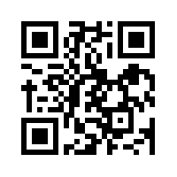
Let’s kahoot!
kahoot.it
create.kahoot.it

Slide 9
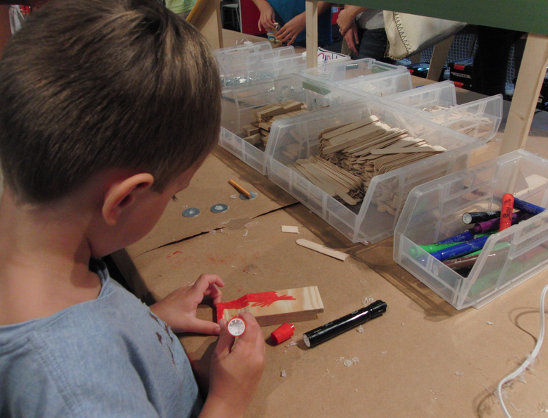
Turning Up the HEAT!
Elementary: The Tinkertoy Derby
Notes:
Click on the link to watch Ms. Toliver’s elementary video and ask participants to evaluate using the HEAT Framework
How could you turn up the HEAT on her lesson (move to the next level)?

Slide 10
Let’s kahoot!
kahoot.it
create.kahoot.it

Slide 11

High Impact Support
for ELL Success

Slide 12
Frameworks
Professional Learning
Onsite Support
Measurement Tools
High Impact Support

Slide 13
Frameworks
Professional Learning
Onsite Support
Measurement Tools
High Impact Support

Slide 14
High Impact Support Frameworks
LoTi
H.E.A.T.

Slide 15
Levels of Teaching Innovation Framework: LoTI
Cognitive Complexity
(High)
LoTi 6
LoTi 5
LoTi 4
Student-directed
LoTi 6
LoTi 5
LoTi 4
Problem-based
LoTi 3
LoTi 2
LoTi 1
Practice-based
LoTi 3
LoTi 2
LoTi 1
Teacher-directed
Cognitive Complexity
(Low)

Slide 16
H.E.A.T. Framework
Higher order thinking
Engaged Learning
Reporting Information
Remembering/Understanding
Applying/Analyzing
Solving teacher-directed problem
Evaluating/ Creating
Solving student directed problem-s
Expansive
Relevant
Limited
Connected
Vague
Authentic Connections
Technology Use
Non-use

Slide 17
Frameworks
Professional Learning
Onsite Support
Measurement Tools
High Impact Support

Slide 22
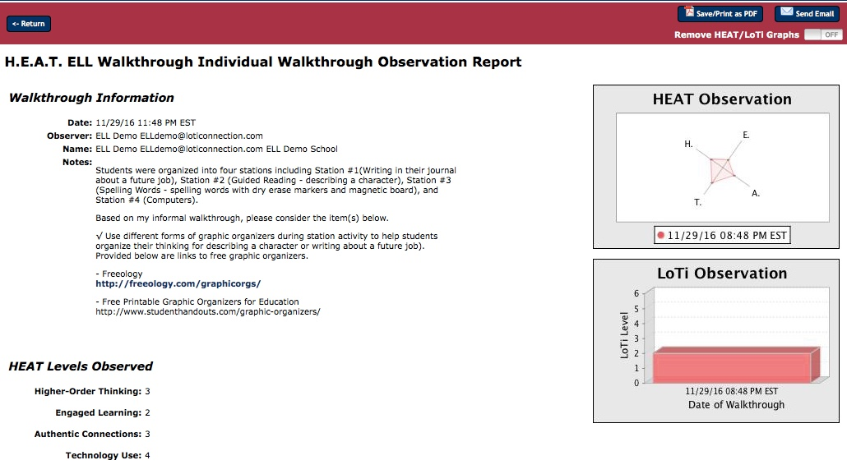
Recommended links for improving practice

Slide 23
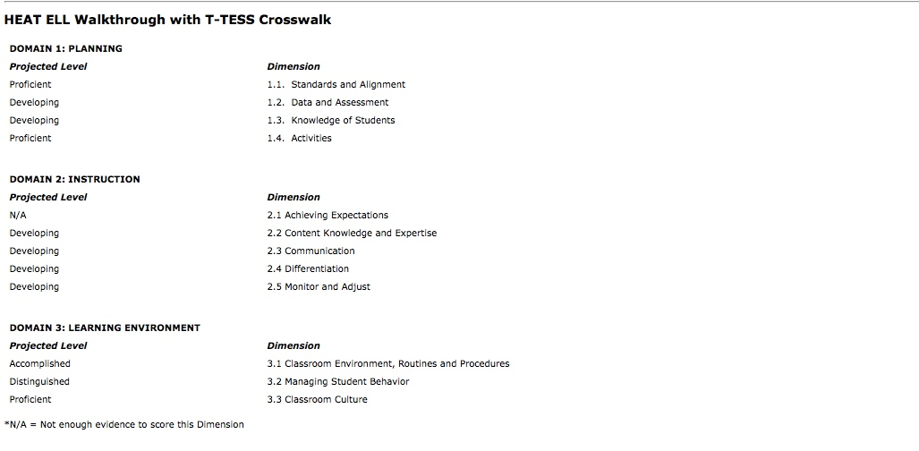
Auto-populates
T-TESS Domains 1, 2, and 3 based on H.E.A.T. input

Slide 24
Frameworks
Professional Learning
Onsite Support
Measurement Tools
High Impact Support

Slide 26
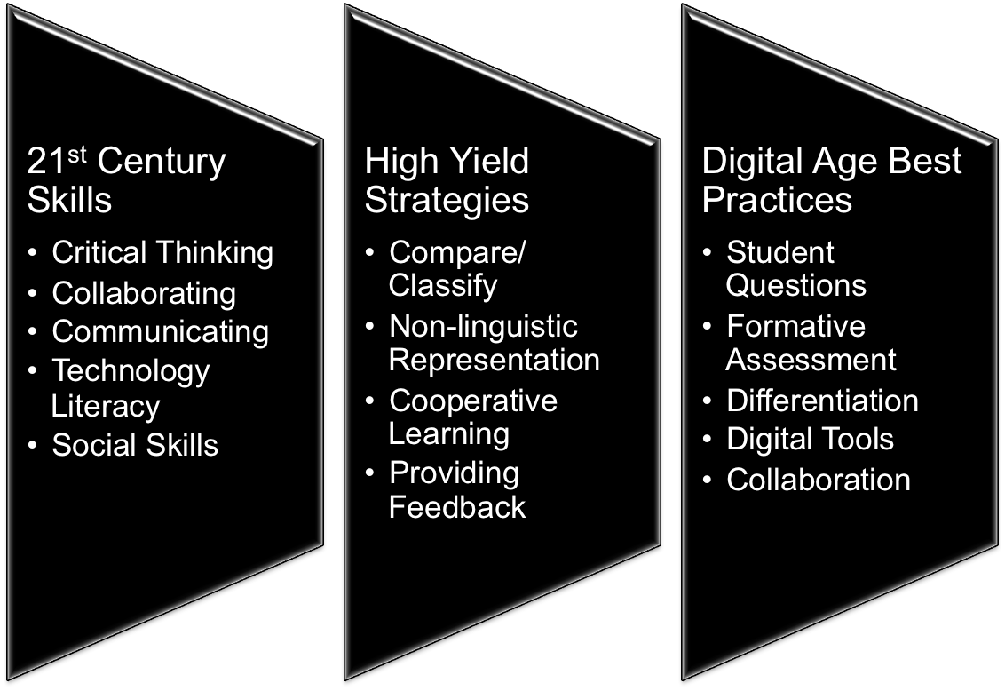
Best Practices
©2017 Region One Education Service Center

Slide 27
ELPS Connections
©2017 Region One Education Service Center

Slide 28
Best Practices
ELPS 1
Content/Language Proficiency Objectives
ELPS 2
Learner interaction, social context, questioning
ELPS 3
Non-linguistic representation
ELPS 4 Collaboration
ELPS 5 Speaking, listening, reading, and writing skills
ELPS 6 Differentiated Learning

Slide 29
Frameworks
Professional Learning
Onsite Support
Measurement Tools
High Impact Support

Slide 30
Measure Opportunities
Integrate Best Practices
Inspire Innovation
Support & Develop

Slide 31
Dr. Chris Moersch
chris@loticonnection.com
Dr. Desiree Marks-Arias
desiree@loticonnection.com

Slide 32

How does the HEAT Framework fit into your plans?

Slide 33

Tickets Out
I used to think…
But now I know…

Slide 34
Thank you!
See you August 2nd
Karina E. Chapa, M.Ed.
Language Proficiency, Biliteracy and Cultural Diversity Director
kchapa@esc1.net
Facebook: Region One ESC Bilingual
Twitter @esc1bilingual

